Slide 1







Stock Price Prediction
with Cross-Firm Integration
Minseo Kim, Jihong Min, Dayoon Lee

Slide 3





01
Goal of the project
02
Related Works
03
Approach
INDEX
04
EDA
05
Baseline

Slide 4



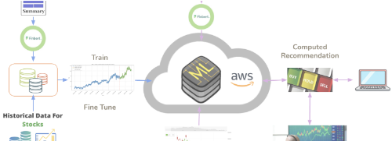
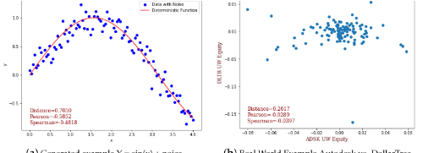


GOAL: CAPTURING "EXTERNAL MARKET CONDITIONS"
Traditional price-only models fail to reflect external factors (News, Macroeconomics).
The key challenge is: How do we capture these efficiently?
Recent Trend: NLP-Based
Our Approach: Interconnectedness
Attemps to capture market conditions directly by processing massive amounts of news text.
Captures market conditions indirectly by analyzing how external shocks ripple through the network.

Slide 5


Related Works
NLP, multimodal based
<LLM-Augmented Linear Transformer–CNN for Enhanced Stock Price Prediction> (Zhou et al., 2025)
→ (-): costly, requires extra resources like financial text.
Interconnectedness, Spillover
<Stock Returns’ Co-Movement: A Spatial Model with Convex Combination of Connectivity Matrices> (Abdallah et al., 2025)
cross- and within-country linkages between different stocks
<Comparative Analysis of Spillover Effects in the Global Stock Market under Normal and Extreme Market Conditions> (Liu et al., 2024)
volatility spillover index to model interconnectedness in 20 major stock markets.
→ (X) use identified comovement patterns, spillover effects in prediction.
→ (X) comparison between nlp-based vs interconnectedness-based

Slide 6
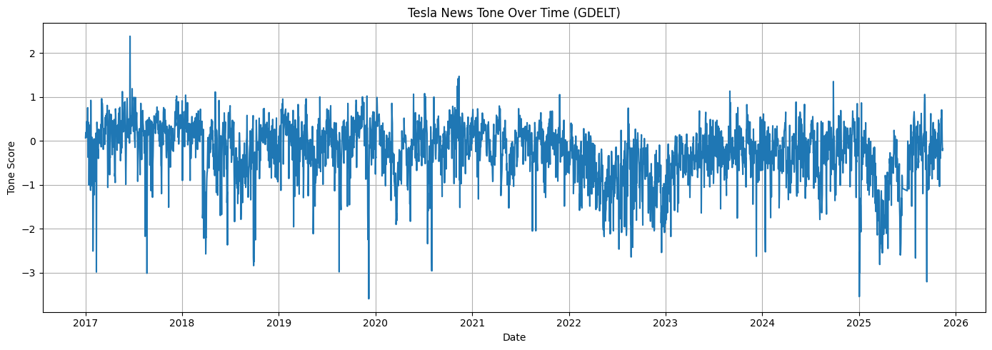
Approach
Sentiment-based | Correlation, interconnectedness-based
GDELT Tone score based on global news articles | Pearson correlation, CCF(Cross-Correlation Function), DTW similarity score, Granger causality test Find correlated features (c.f: log-return, volatility) → VARMA/LSTM

Slide 7

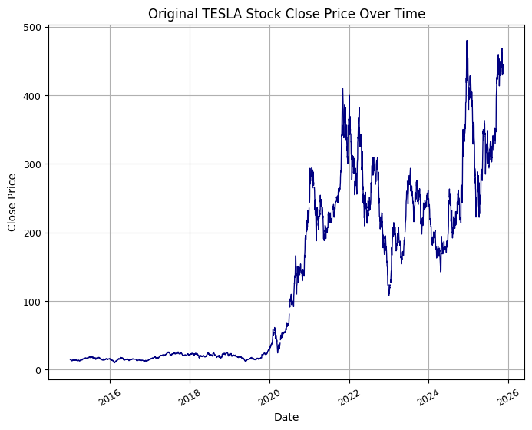
EDA
01
Rapid increase, Rapid drop
02
Missing value check
03
Outlier Check

Slide 8

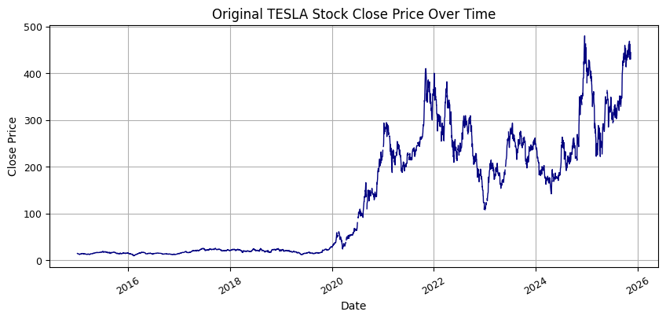
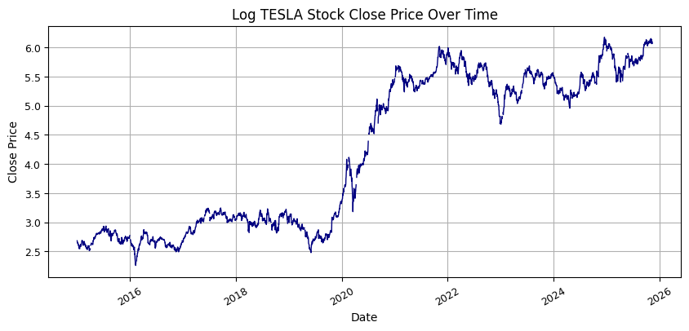
Log transformation
1
Apply log transformation to adjust scale

Slide 9
Missing Value
Missing Value occurs during the process of aligning domestic and international companies
1

Slide 10
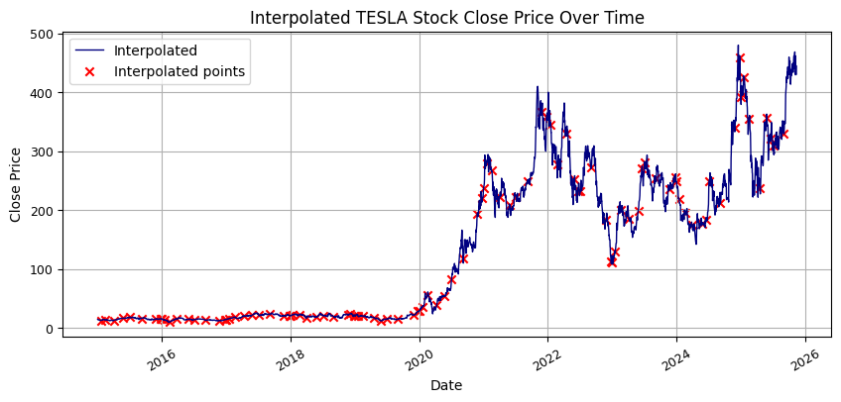
Missing Value
1
101 interpolated points follows original trends with interpolation

Slide 11
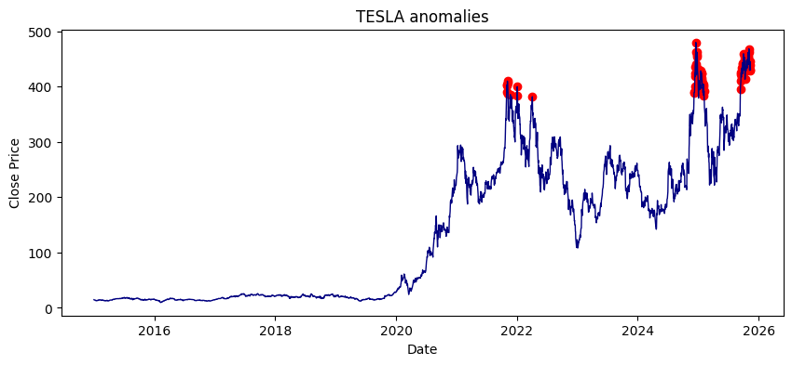
Outlier check
1
Prices after the sharp increase are considered as outliers when detecting with 3𝛔
However, these values reflects characteristics of TESLA data → preserve them

Slide 12
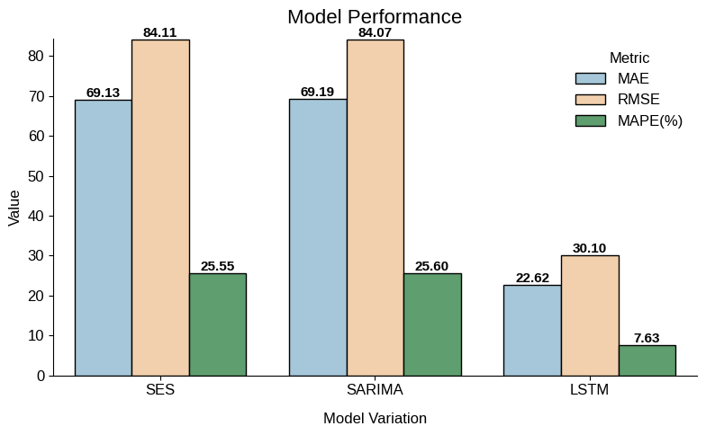
Baseline Performance
1
LSTM capture variations relatively well and achieves moderate performance

Slide 13
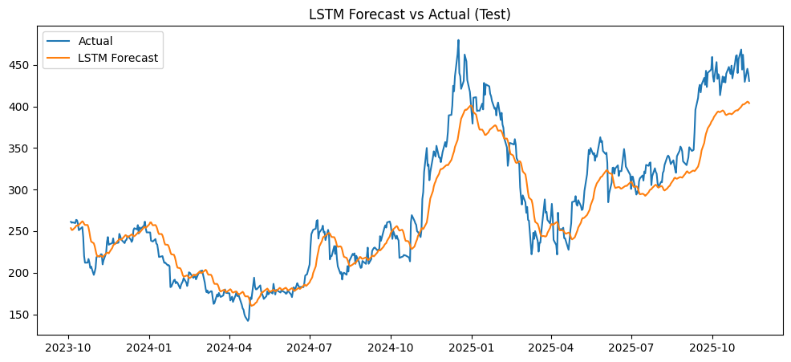
Baseline Performance
1
However, there’s still gap between prediction and real prices

Slide 14
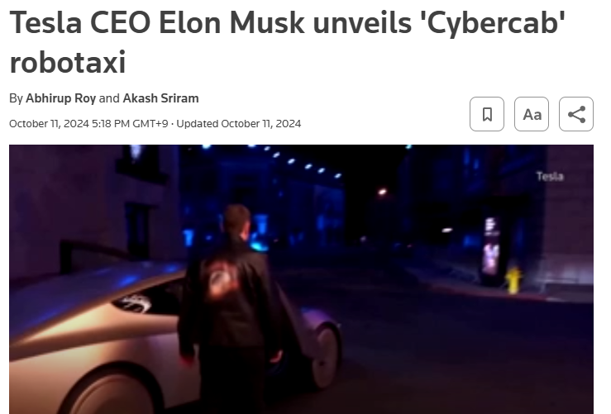

Baseline Performance
2024 October
2025 November
1
Fails to handle sharp increase caused by external events.
Cybercab release: Cannot reflect with hyundai data
EV market expansion: Can reflect with hyundai data

Slide 15
Summary
01
Naive approach fail to capture variation caused by external events
02
NLP-based approach suggested by previous approach are too costly
03
Check efficiency of interconnectedness-based approach
by comparing it to sentiment-based approach

